Slide 1
Artificial J.A.M.A
Team Members: Joshua Roasa, A’nya Carr, Molisha Khosla, Adriana Altamirano

Slide 2
Meet the Team
J
A
M
A
Joshua
Back End Developer
Adriana
Front End Developer
Molisha
Front End Developer
Anya
Back End Developer

Slide 3
Introduction/Topic
Our project aims to create a Resume Parser using AI to enhance the hiring process for job recruiters and simplify the job application process for applicants. The Resume Parser will scan resumes to assess whether an applicant's qualifications meet the job requirements and provide feedback to the applicant if their resume requires improvement.
Languages used: HTML/CSS, Bootstrap, PHP, MySQL, JavaScript, AJAX
Software: Figma, MySQL WorkBench, VScode, Replit, Obi2 server, LucidChart

Slide 4
Objective
Empower recruiters to efficiently identify and source talented applicants by eliminating the barrier caused by format issues and mitigating bias from AI that may prevent otherwise qualified candidates from passing through resume parsing systems.
On the applicant side, the goal is to provide candidates with real-time feedback, specifically addressing any formality issues within their resumes.
This approach aims to ensure a smoother and more inclusive application process, fostering better matches between talented individuals and prospective employers.

Slide 5
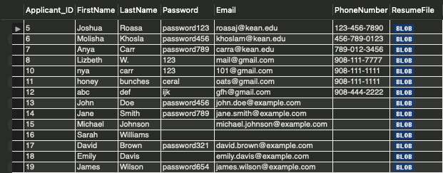
MySQL Tables
Applicant

Slide 6
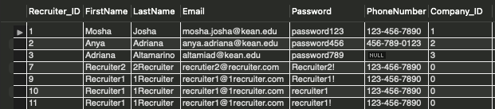
MySQL Tables
Recruiter

Slide 7
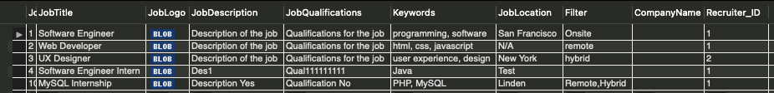
MySQL Tables
Job

Slide 8
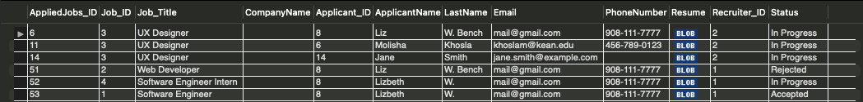
MySQL Tables
AppliedJob

Slide 9
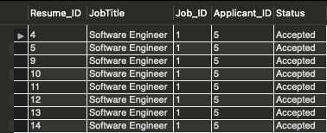
MySQL Tables
Resume

Slide 10
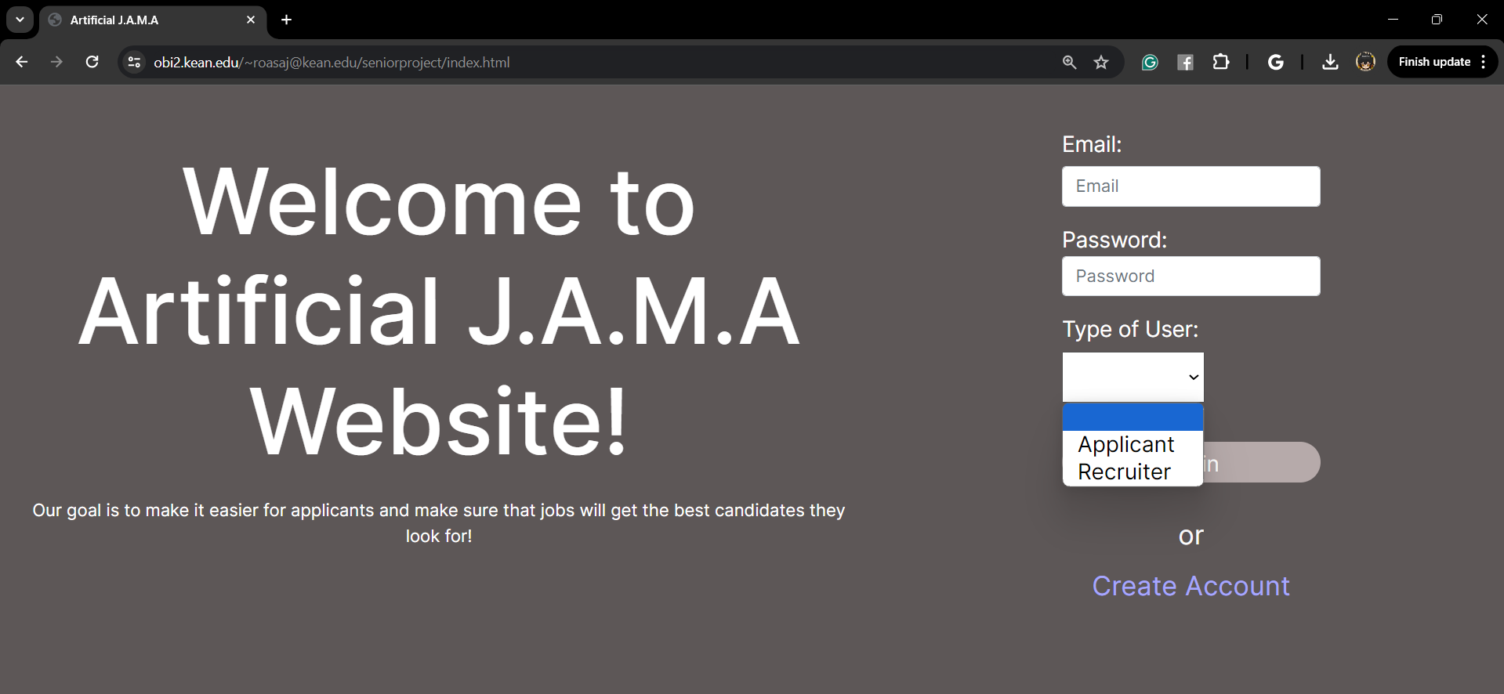
Home Page:

Slide 11
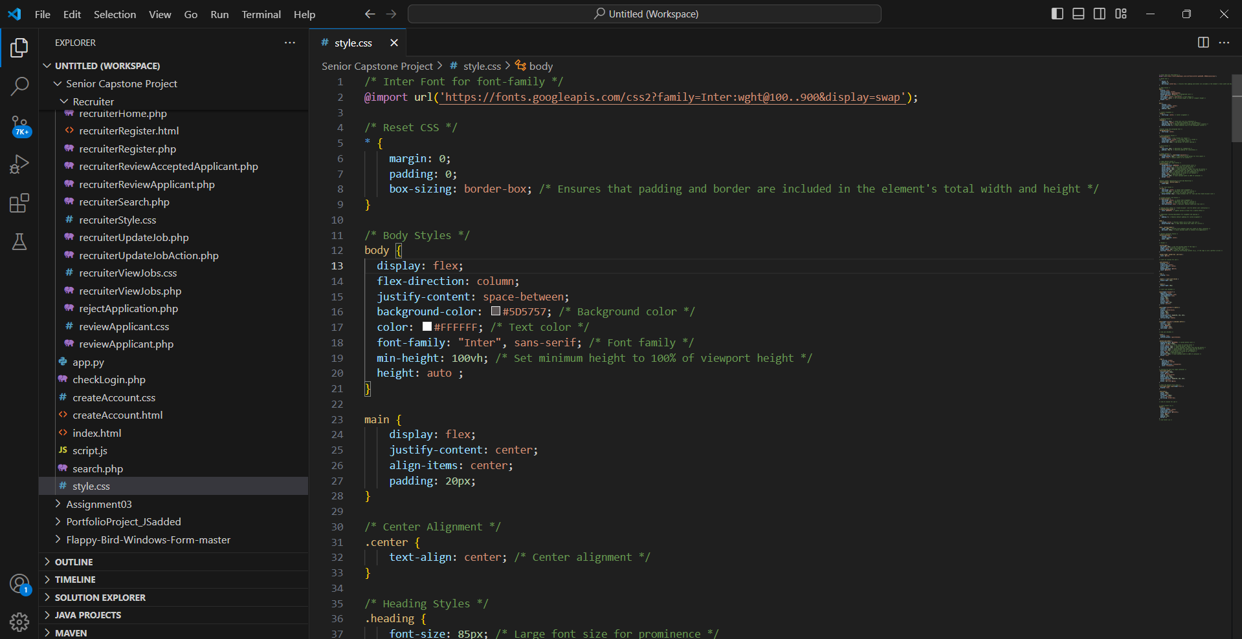
General Style.css

Slide 12
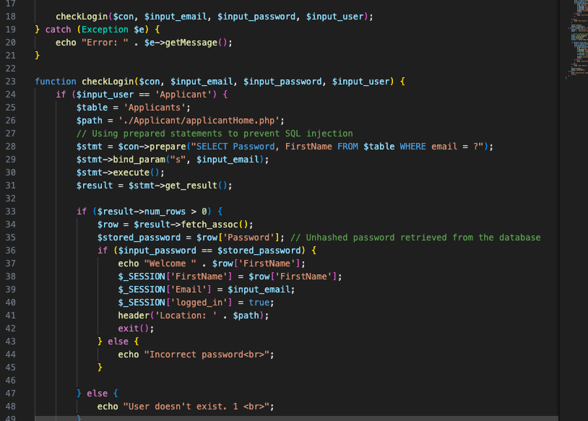
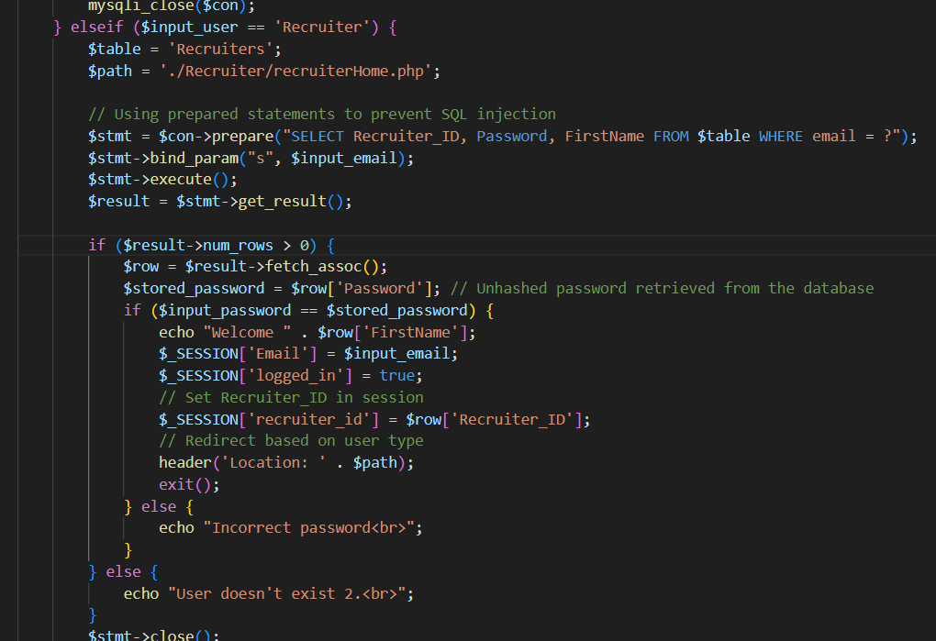
CheckLogin Back-end

Slide 13
Applicant Side

Slide 14
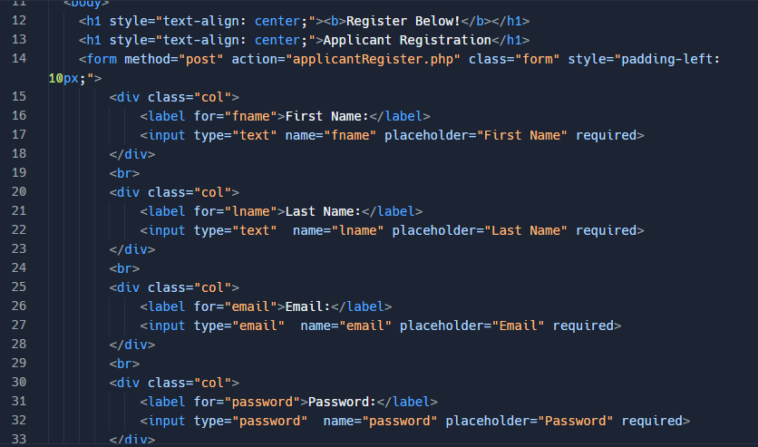
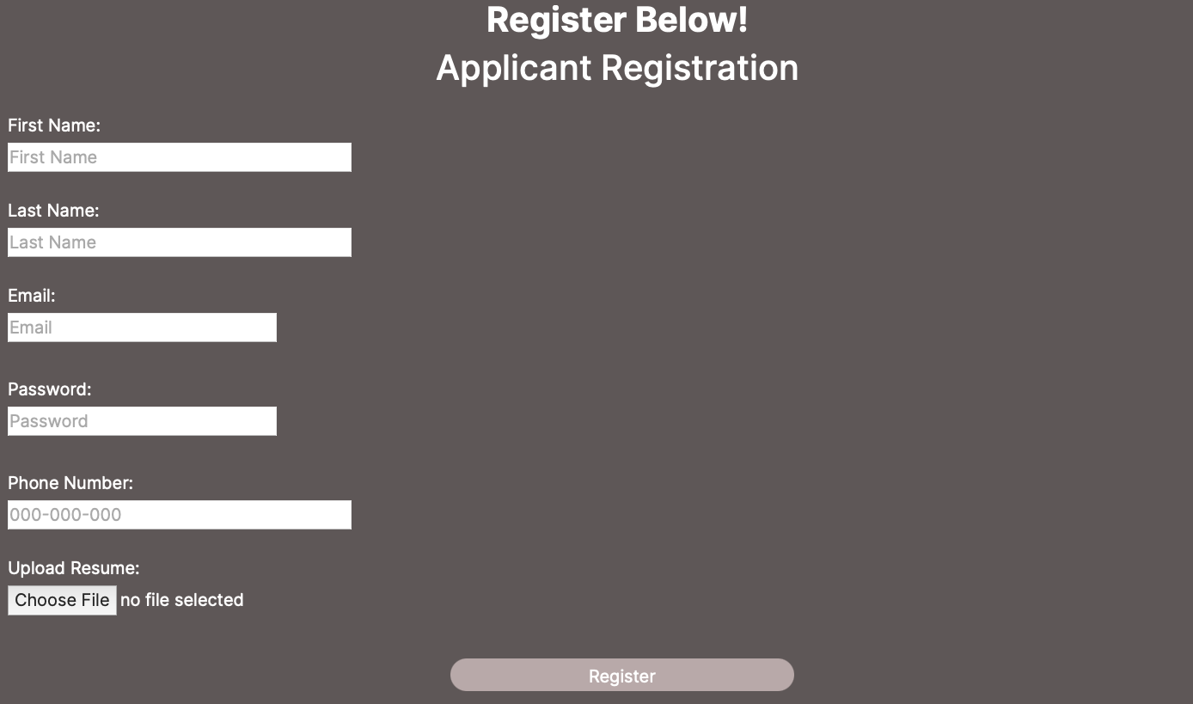
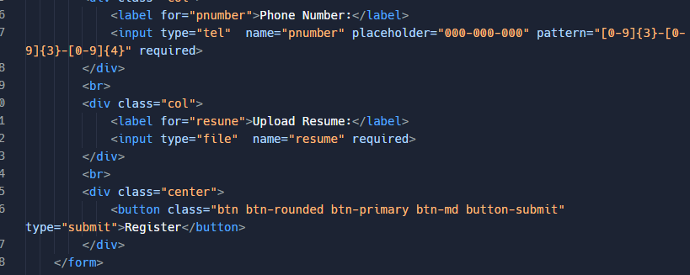
Applicant Registration Page Front-End

Slide 15
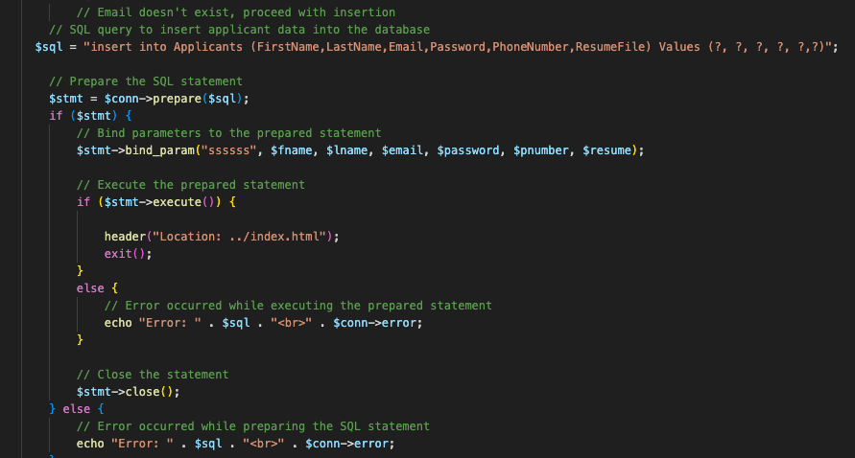
Applicant Registration Page Back-End

Slide 16
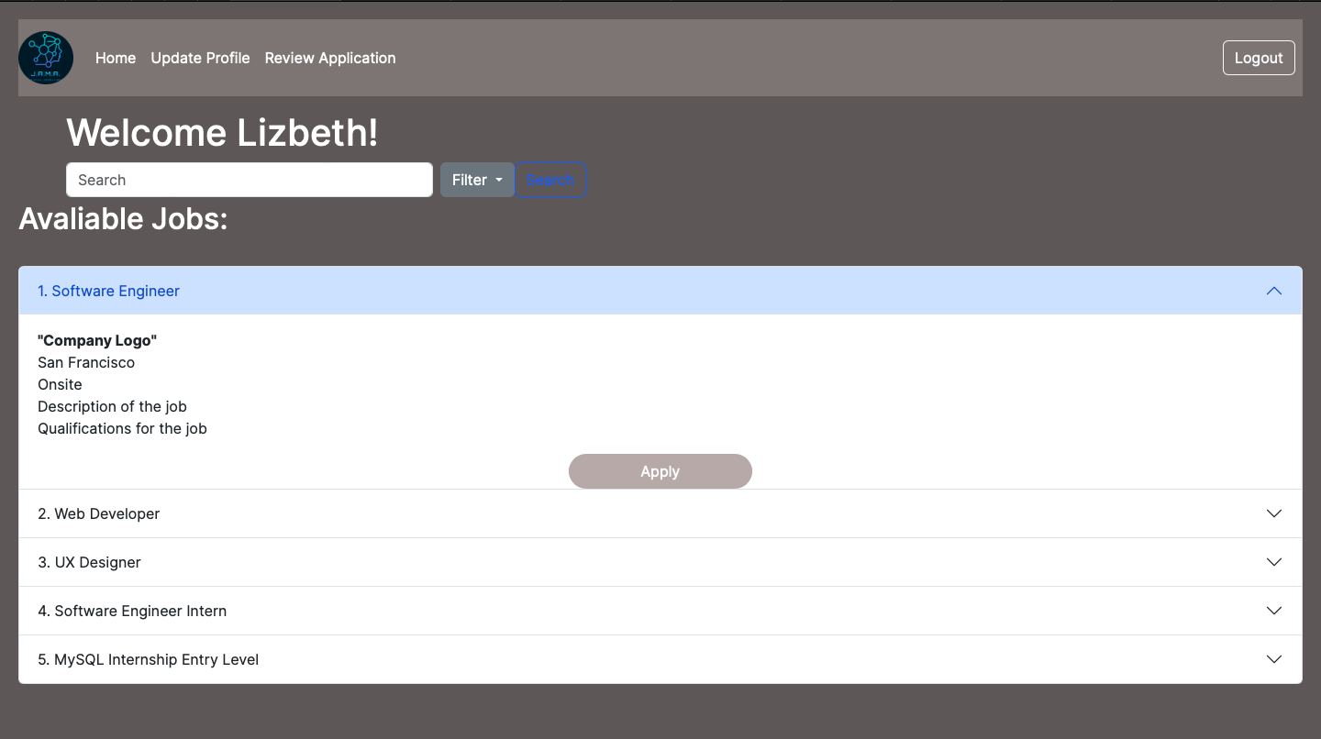
Applicant Homepage Front-End

Slide 17
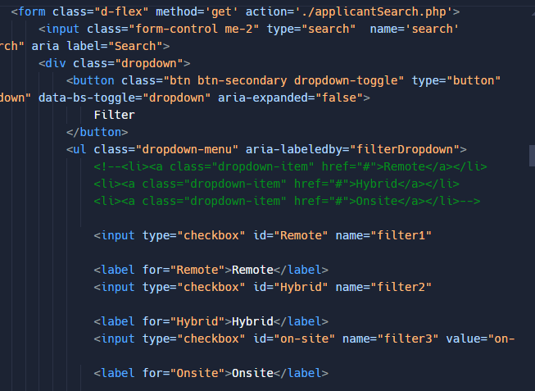
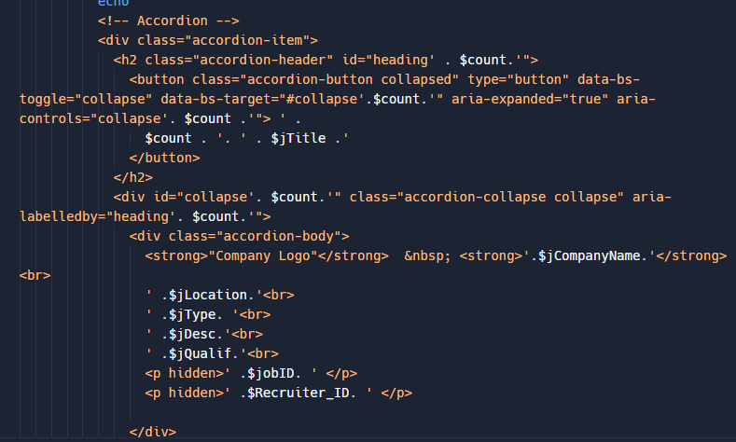
Applicant Homepage Front-End

Slide 18
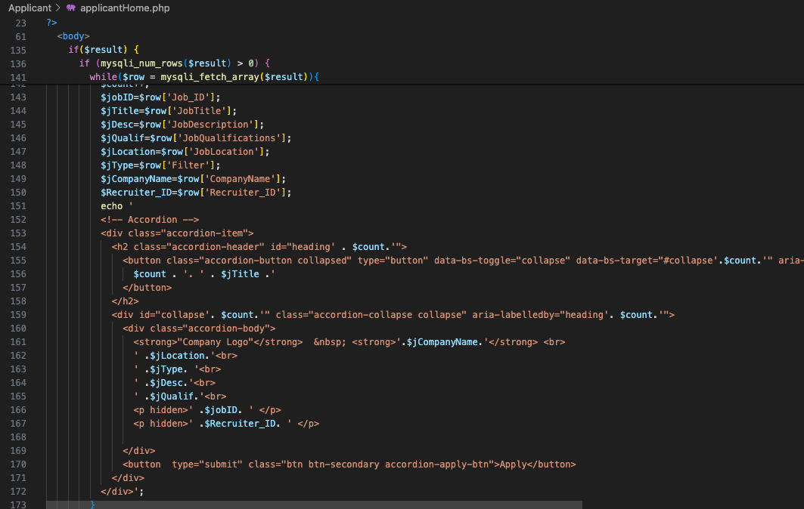
Applicant Homepage Back-End

Slide 19
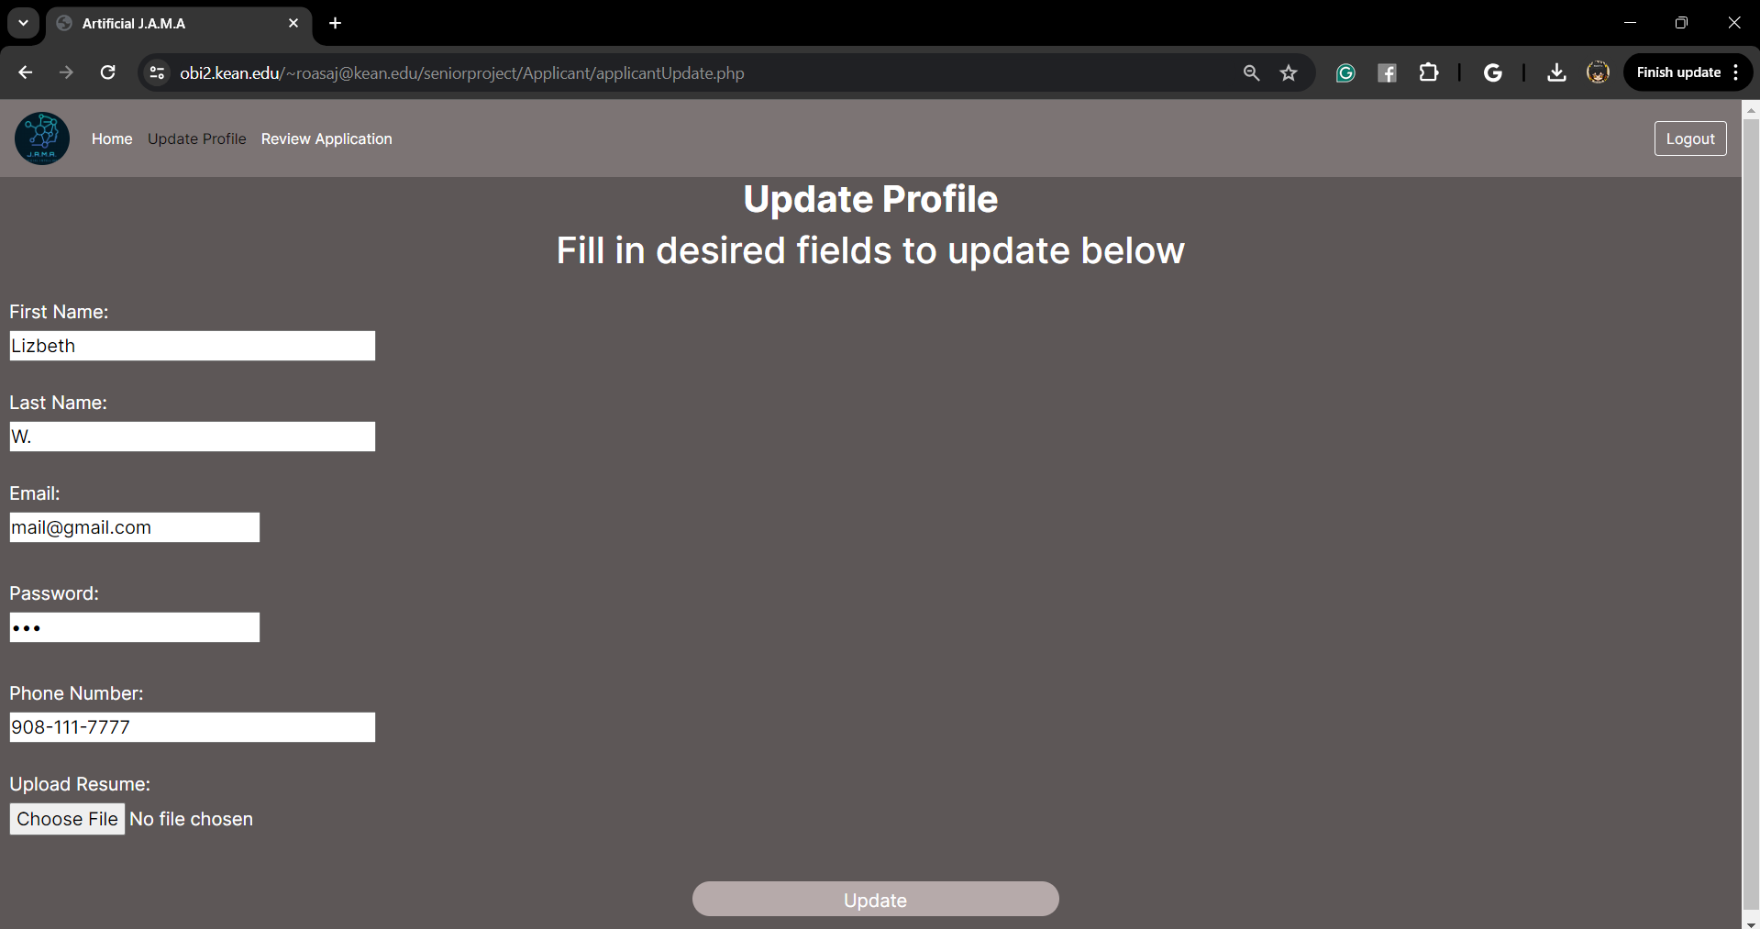
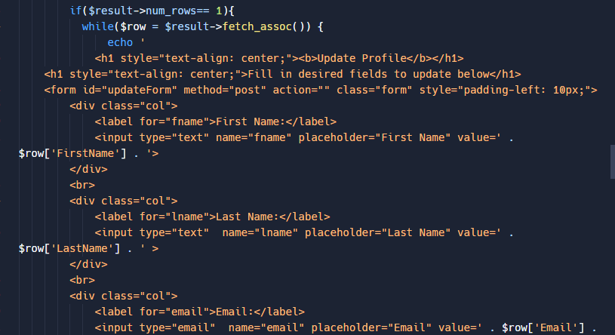
Applicant Update Profile Front-End

Slide 20
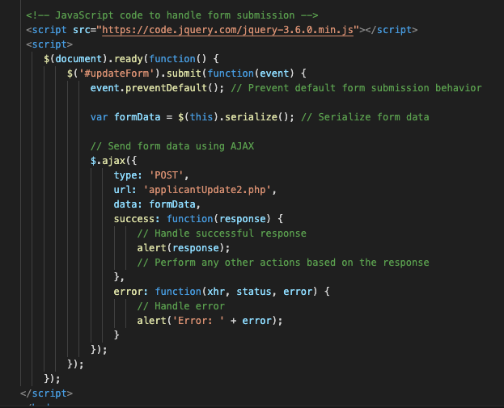
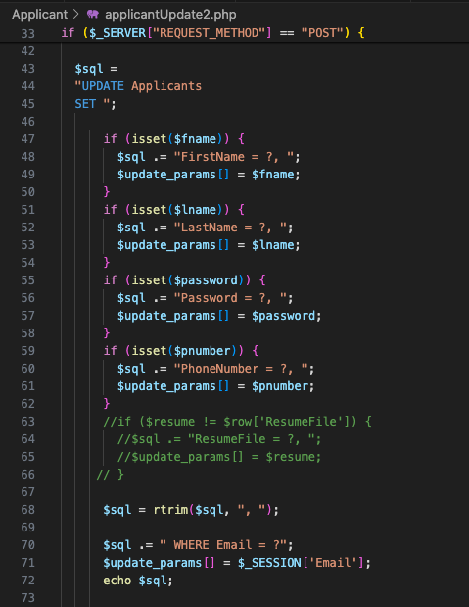
Applicant Update Profile Back-End

Slide 21
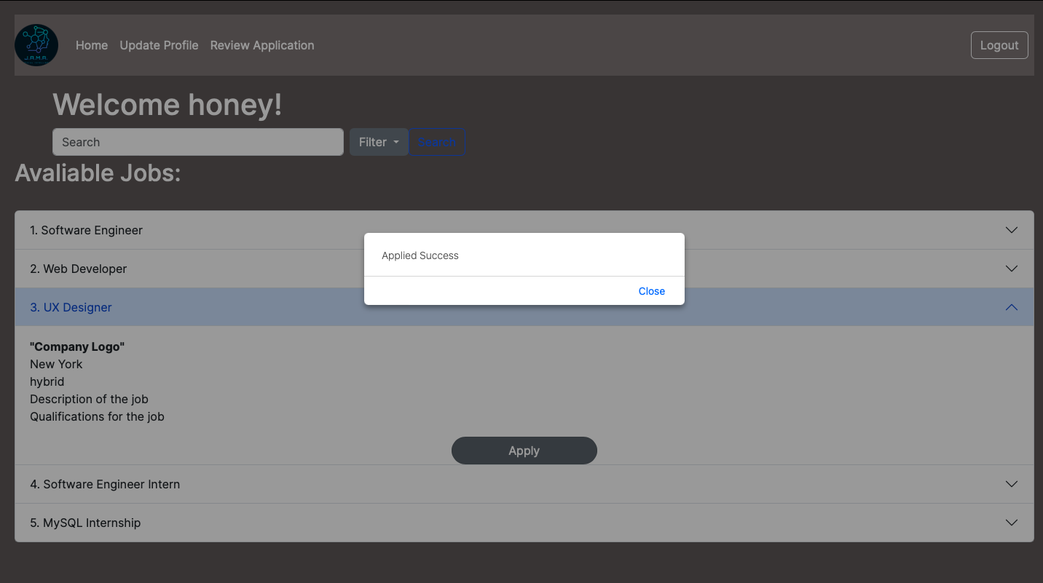
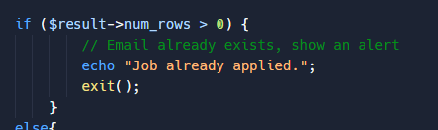
Applicant Apply Front-End

Slide 22
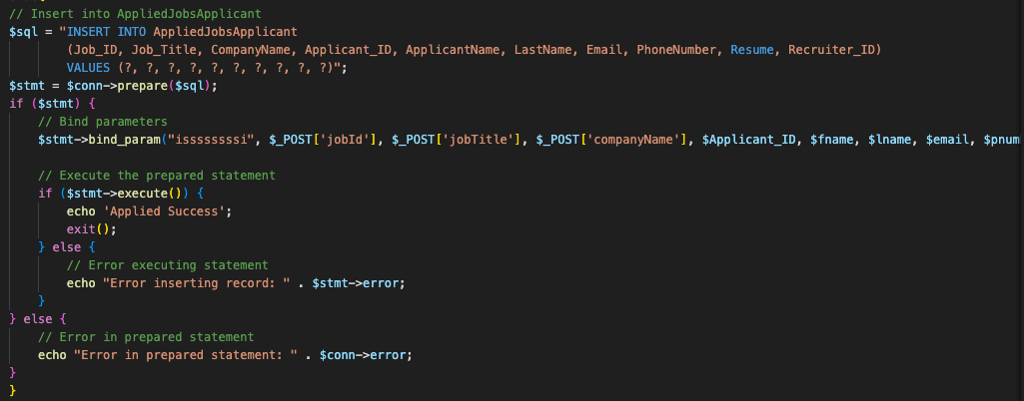
Applicant Apply Back-End

Slide 23
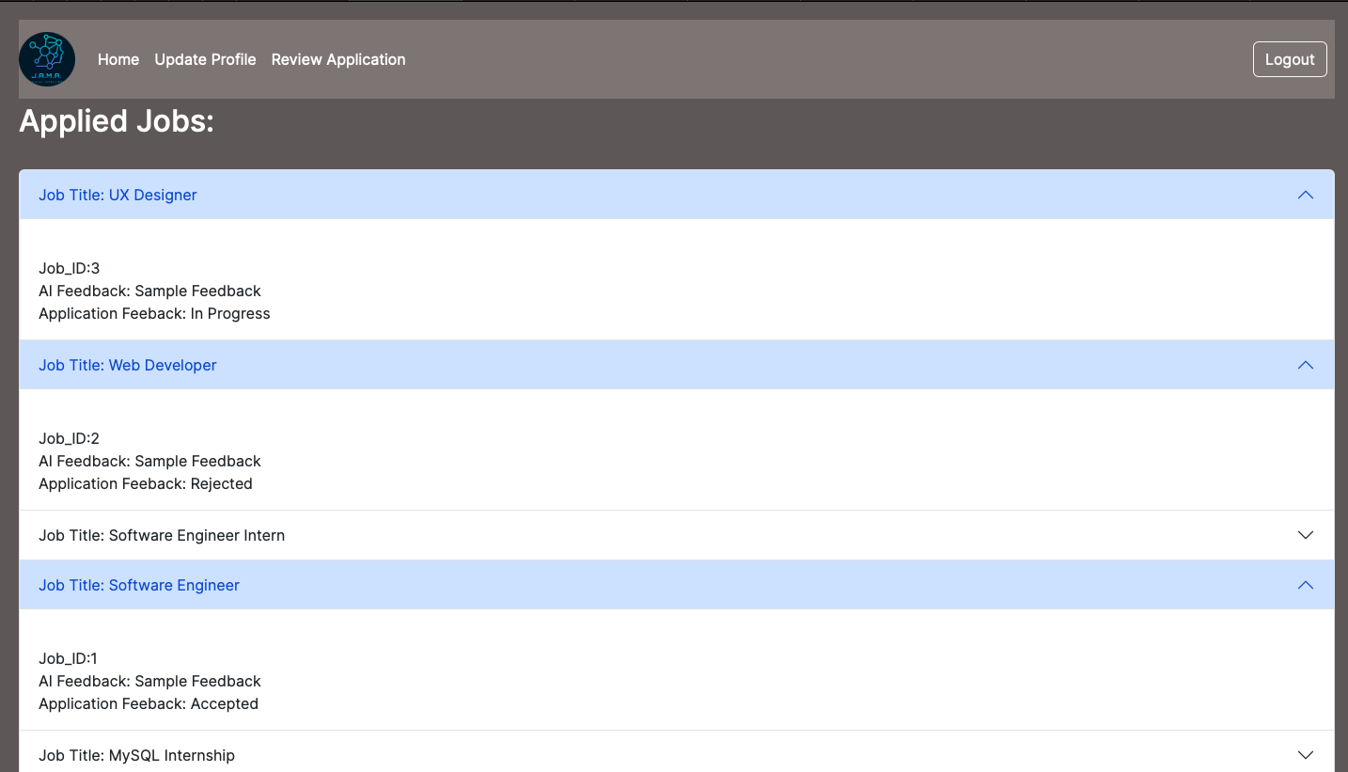
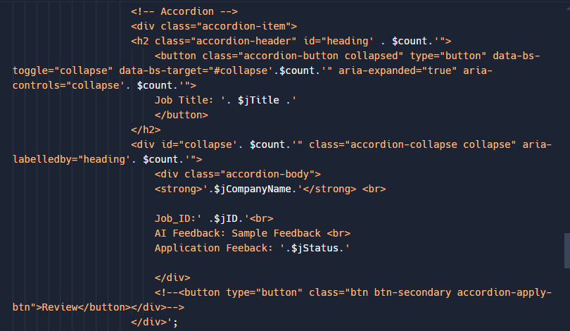
Applicant Review Application Front-End

Slide 24
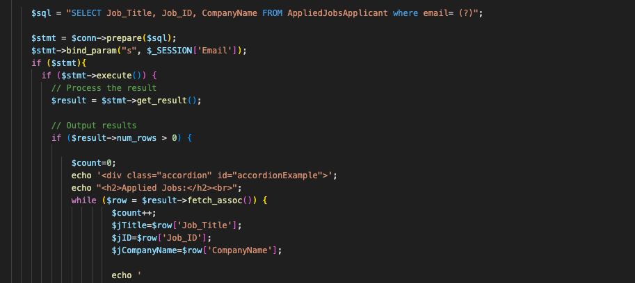
Applicant Review Application Back-End

Slide 25
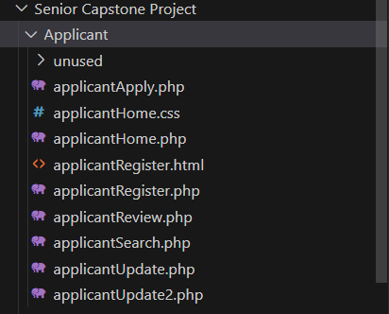
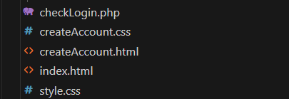
Applicant and
General Files Overview

Slide 26
Recruiter Side

Slide 27
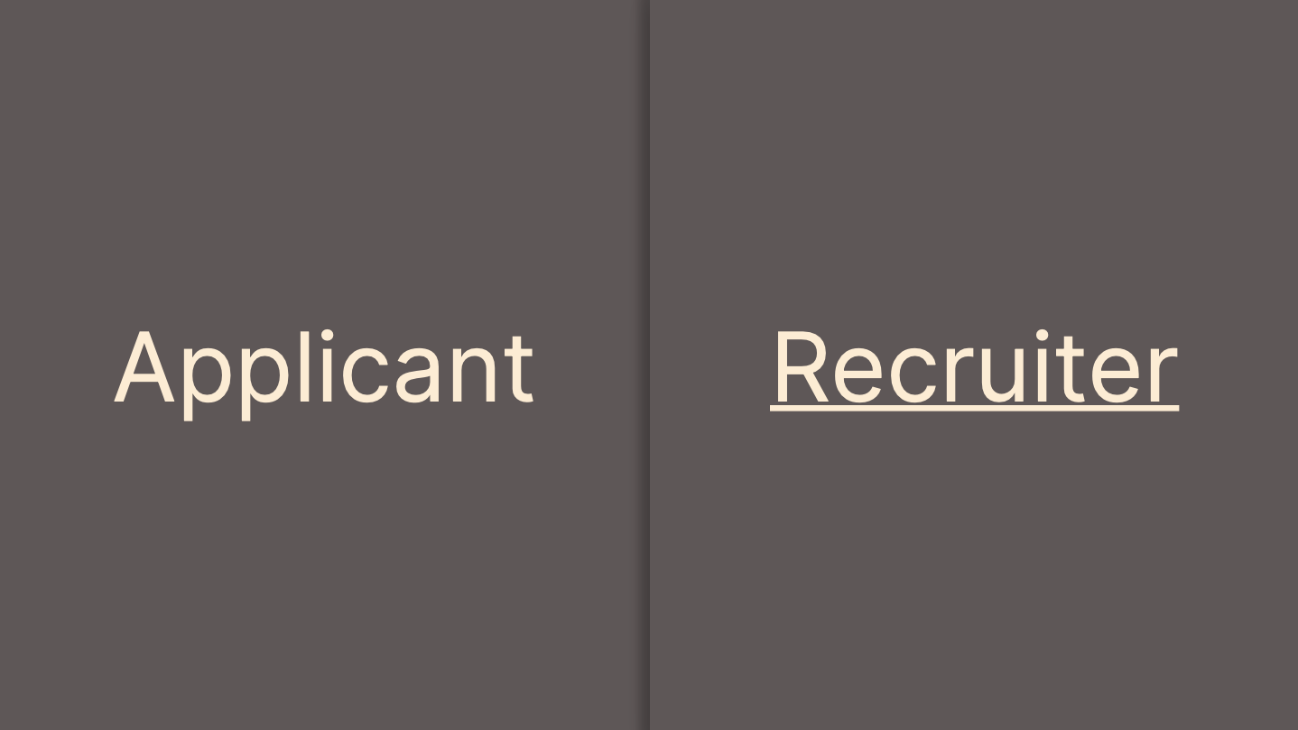
Recruiter Registration Page Front-end

Slide 28
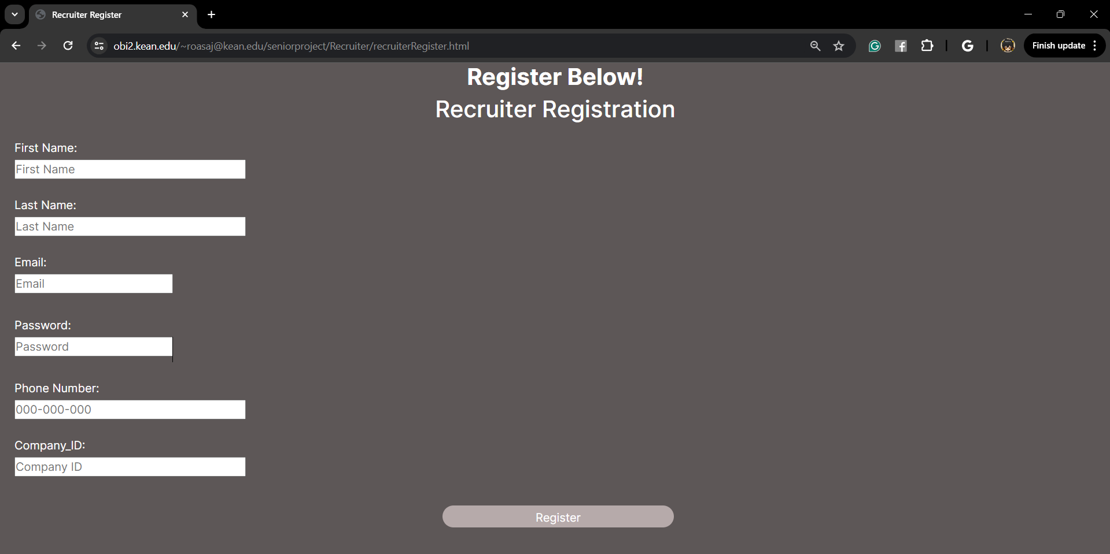
Recruiter Registration Page Front-end

Slide 29
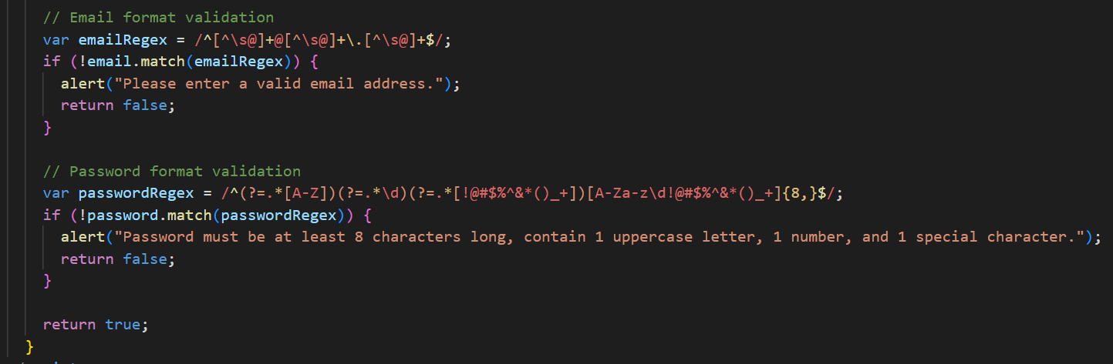
Recruiter Registration Page Front-end

Slide 30
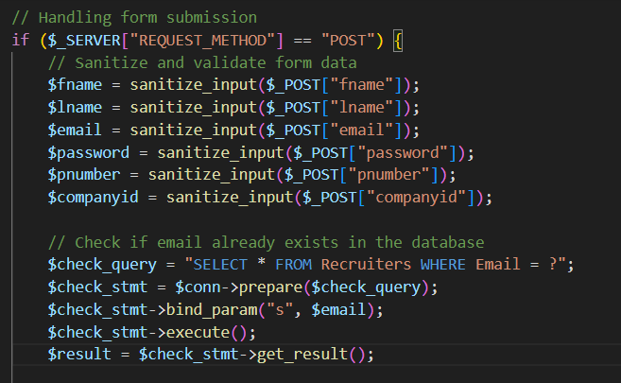
Recruiter Registration Page Back-end

Slide 31
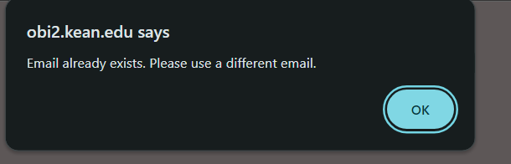
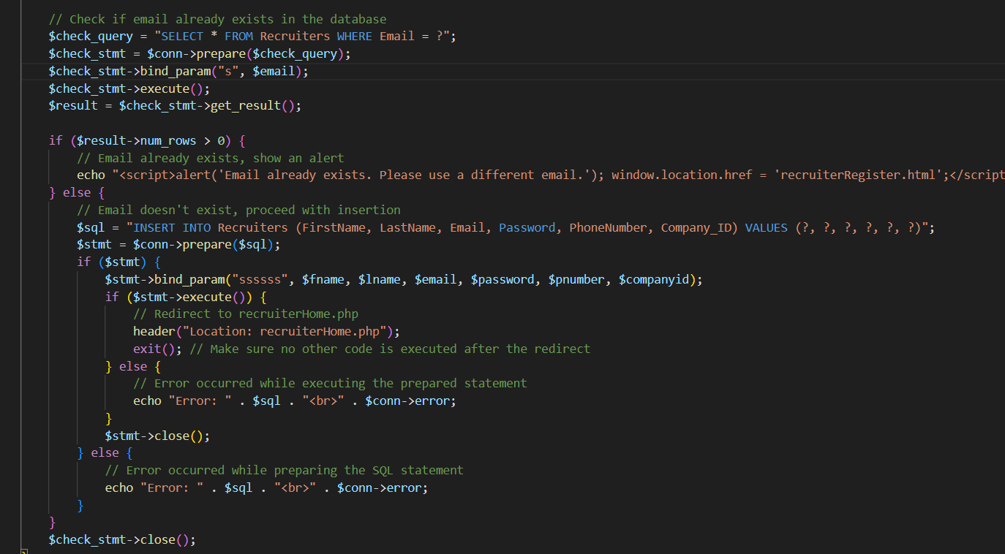
Recruiter Registration Page Back-end

Slide 32
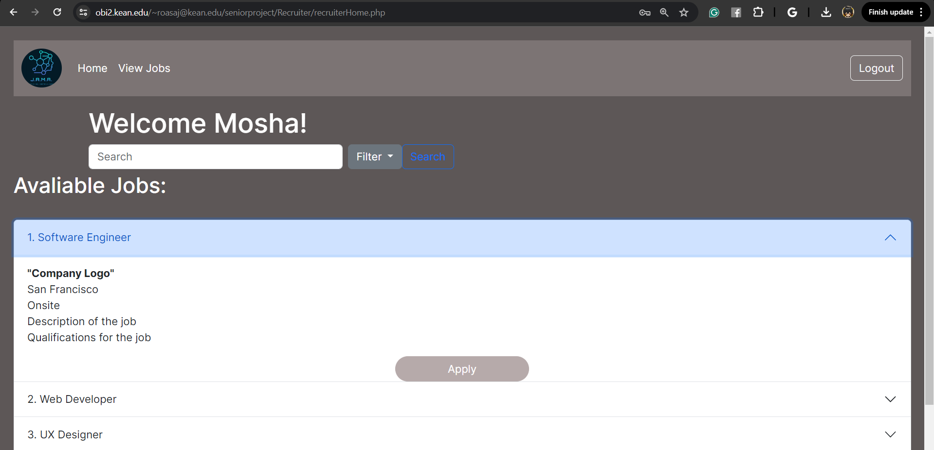
Recruiter Home Page Front-end

Slide 33
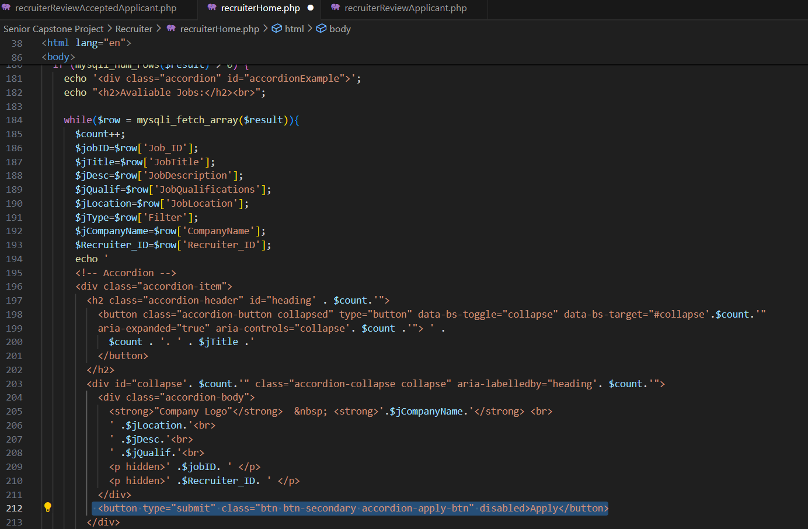
Recruiter Home Page Back-end

Slide 34
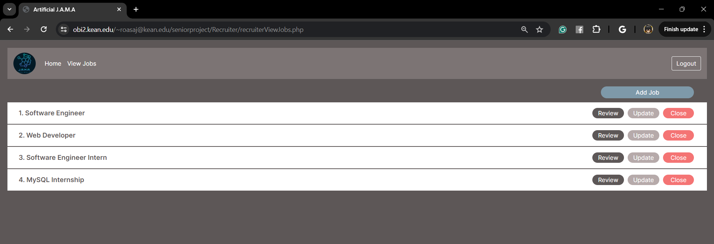
Recruiter View Job Page Front-end

Slide 35
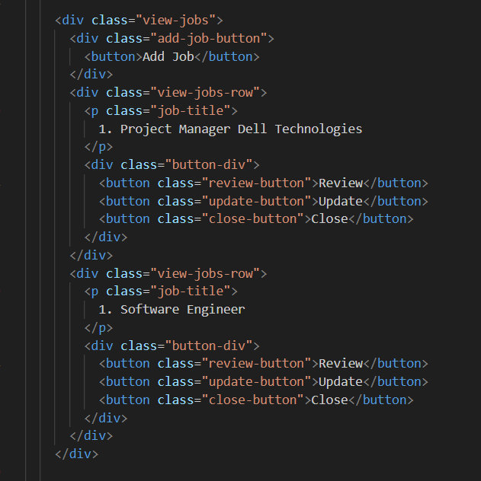
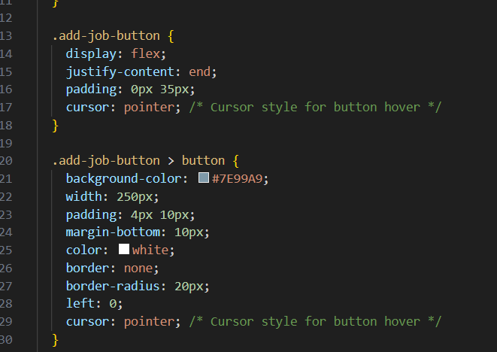
Recruiter View Job Page Front-end

Slide 36
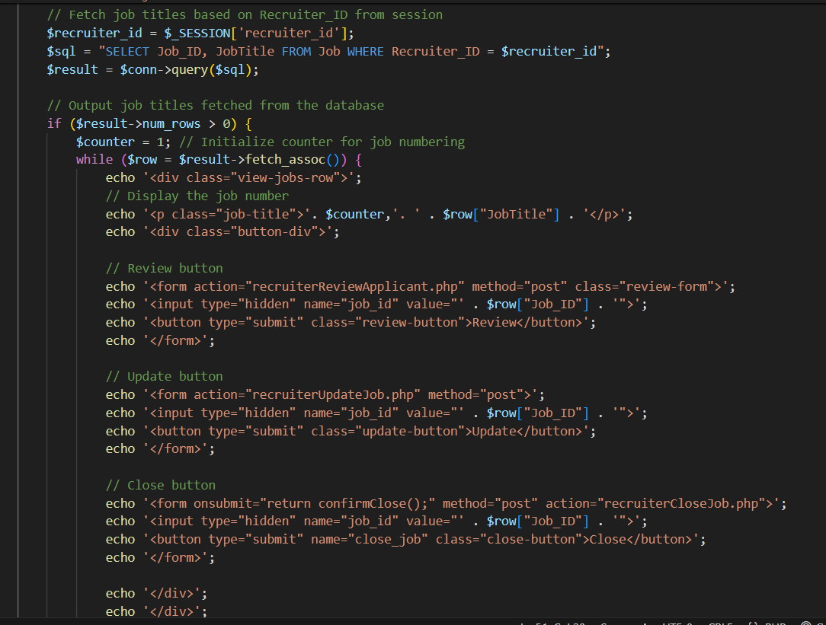
Recruiter View Job Page Back-end

Slide 37
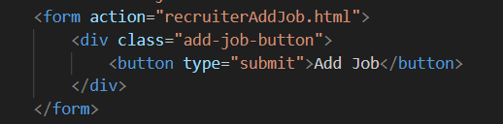
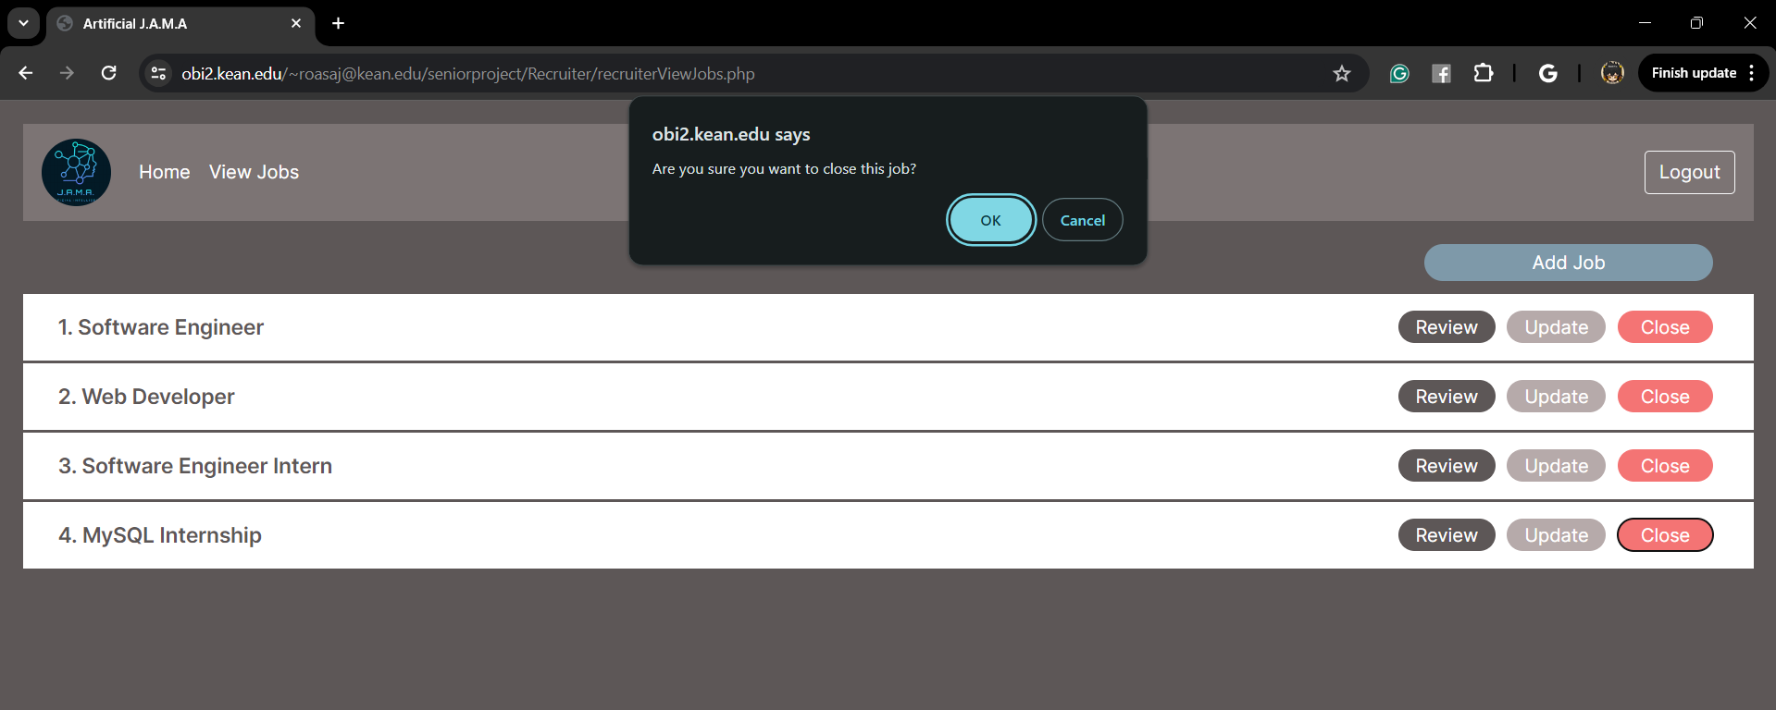
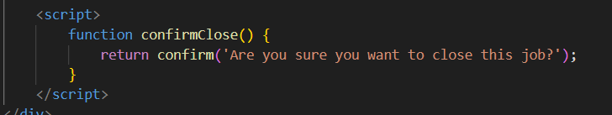
Recruiter View Job Page Back-end

Slide 38
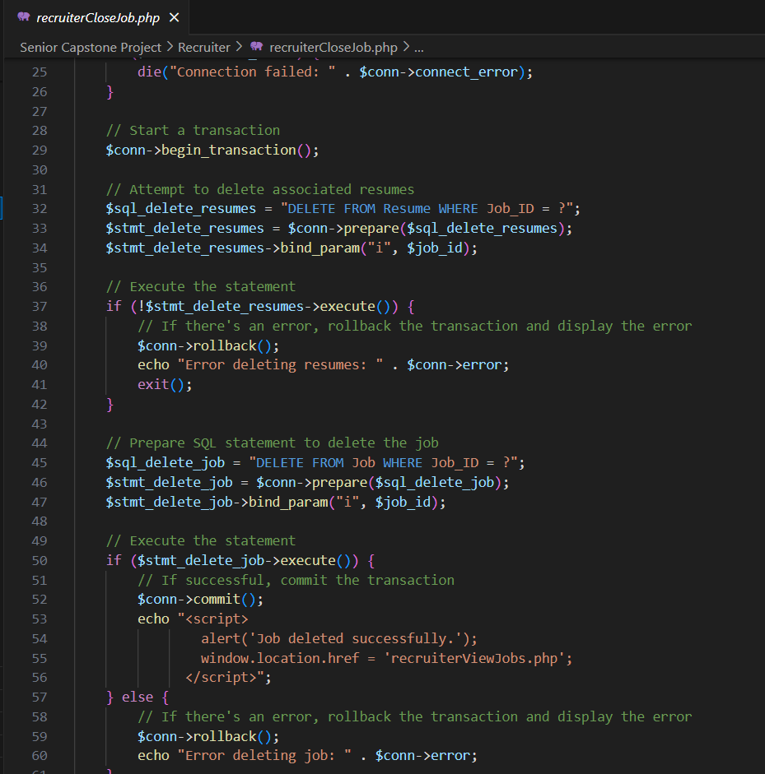
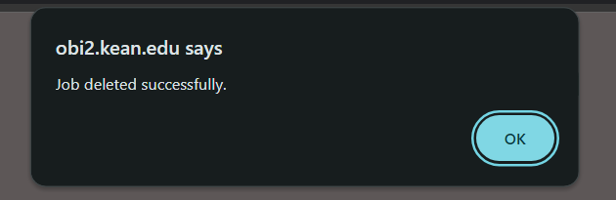

Slide 39
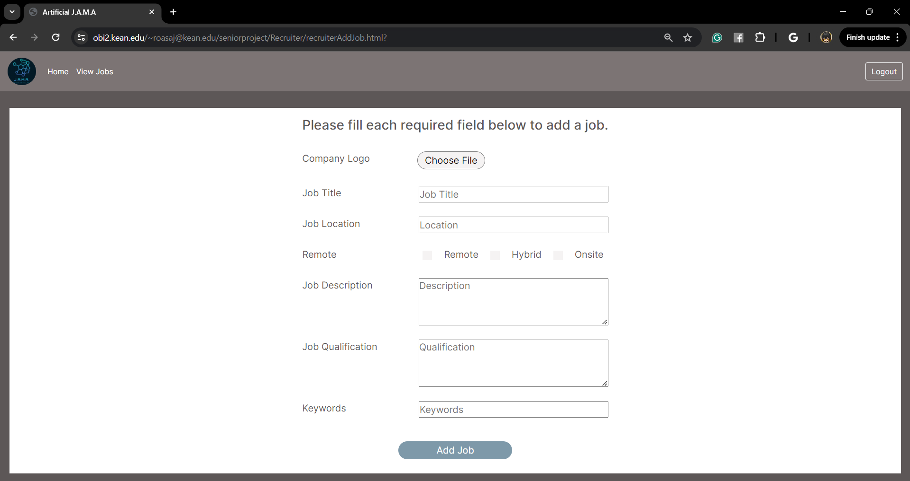
Add Job Page Front-end

Slide 40
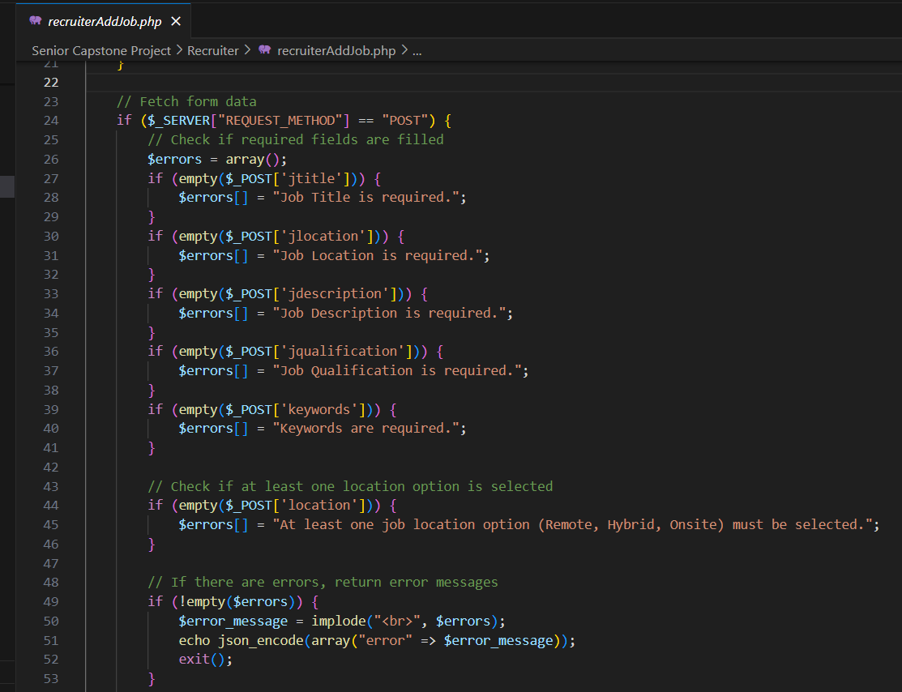
Add Job Page Back-end

Slide 41
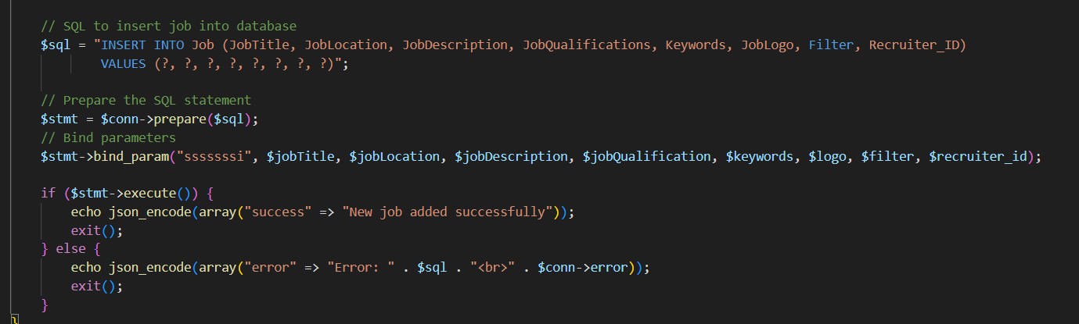
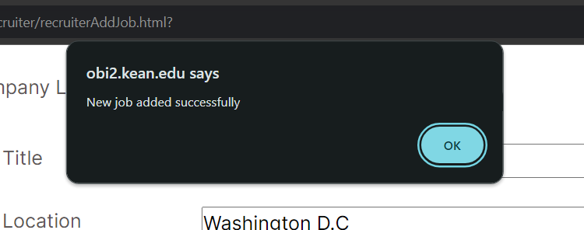
Add Job Page Back-end

Slide 42


Recruiter Review Applicant Page Front-end

Slide 43


Recruiter Review Applicant Page Back-end

Slide 44

Recruiter Accept Applicant back-end

Slide 45

Recruiter Reject Applicant back-end

Slide 46


Recruiter Review Applicant Page Back-end

Slide 47


Review Accepted Applicant Front-end

Slide 48


Review Accepted Applicant Back-end

Slide 49

Recruiter Update Job Page Front-end

Slide 50

Recruiter Update Job Page Back-end

Slide 51

Recruiter Update Job Page Back-end

Slide 52



Recruiter Update Job Page Back-end

Slide 53

Recruiter Side All Files

Slide 54

Extracting Data from Resume
Quick Demo: https://colab.research.google.com/drive/1D_gt7VacOTZJM3TZnvfrfvClUozh7kF6?usp=sharing

Slide 55
Challenges
Adriana - using bootstrap and css as css would always override, and making sure that if I made any changes it would change the whole webpage, difficulty making responsive, and filter dropdown
A’nya- Different coding implementations for same function between Applicant and Recruiter sides caused confusion. Limited knowledge on 3 tier architecture, Time constraints
Molisha- I got stuck dealing with the view jobs row- review, update and close button and adding footer.
Joshua - Converting HTML file and CSS into PHP, fixing bugs, compatibility issue, inserting company logo into database, Time constraints.

Slide 56
Future Work
Update Filter multi value to be a table
Make code implementation consistent on Recruiter and Applicant side
Find efficient way to store pdfs and docx in database
With Recruiter’s special keywords, AI will calculate how much a resume consists of those words, determining what gets reviewed by Recruiter.
Have AI give feedback based on accept or reject

Slide 57
Software Development Life Cycle(SDLC)
Phase 1 Planning ( Week 1) & Phase 2 Planning (Week 1 - Week 2)
Phase 1: Identifying Problems (Planning)
Phase 2: Determine Human Information Requirements (Planning)
Phase 3 Analysis (Week 2 - Week 3)
Phase 4 Design (Week 3 - Week 4)
Phase 5 Implementation (Week 4 - Week 10)
Phase 6 Testing & Integration (Week 10 - Week 13)
Phase 7 Maintenance (Week 13 - Week 15)

Slide 58

OVERVIEW OF PLAN

Slide 59

Result
https://obi2.kean.edu/~roasaj@kean.edu/seniorproject/index.html
Scan QR Code: Send link from phone to Laptop.
Try it on your Laptop or PC.
Not Optimized for Mobile
QR Code

Slide 60
Thank You!
Any Questions?

